Slide 1
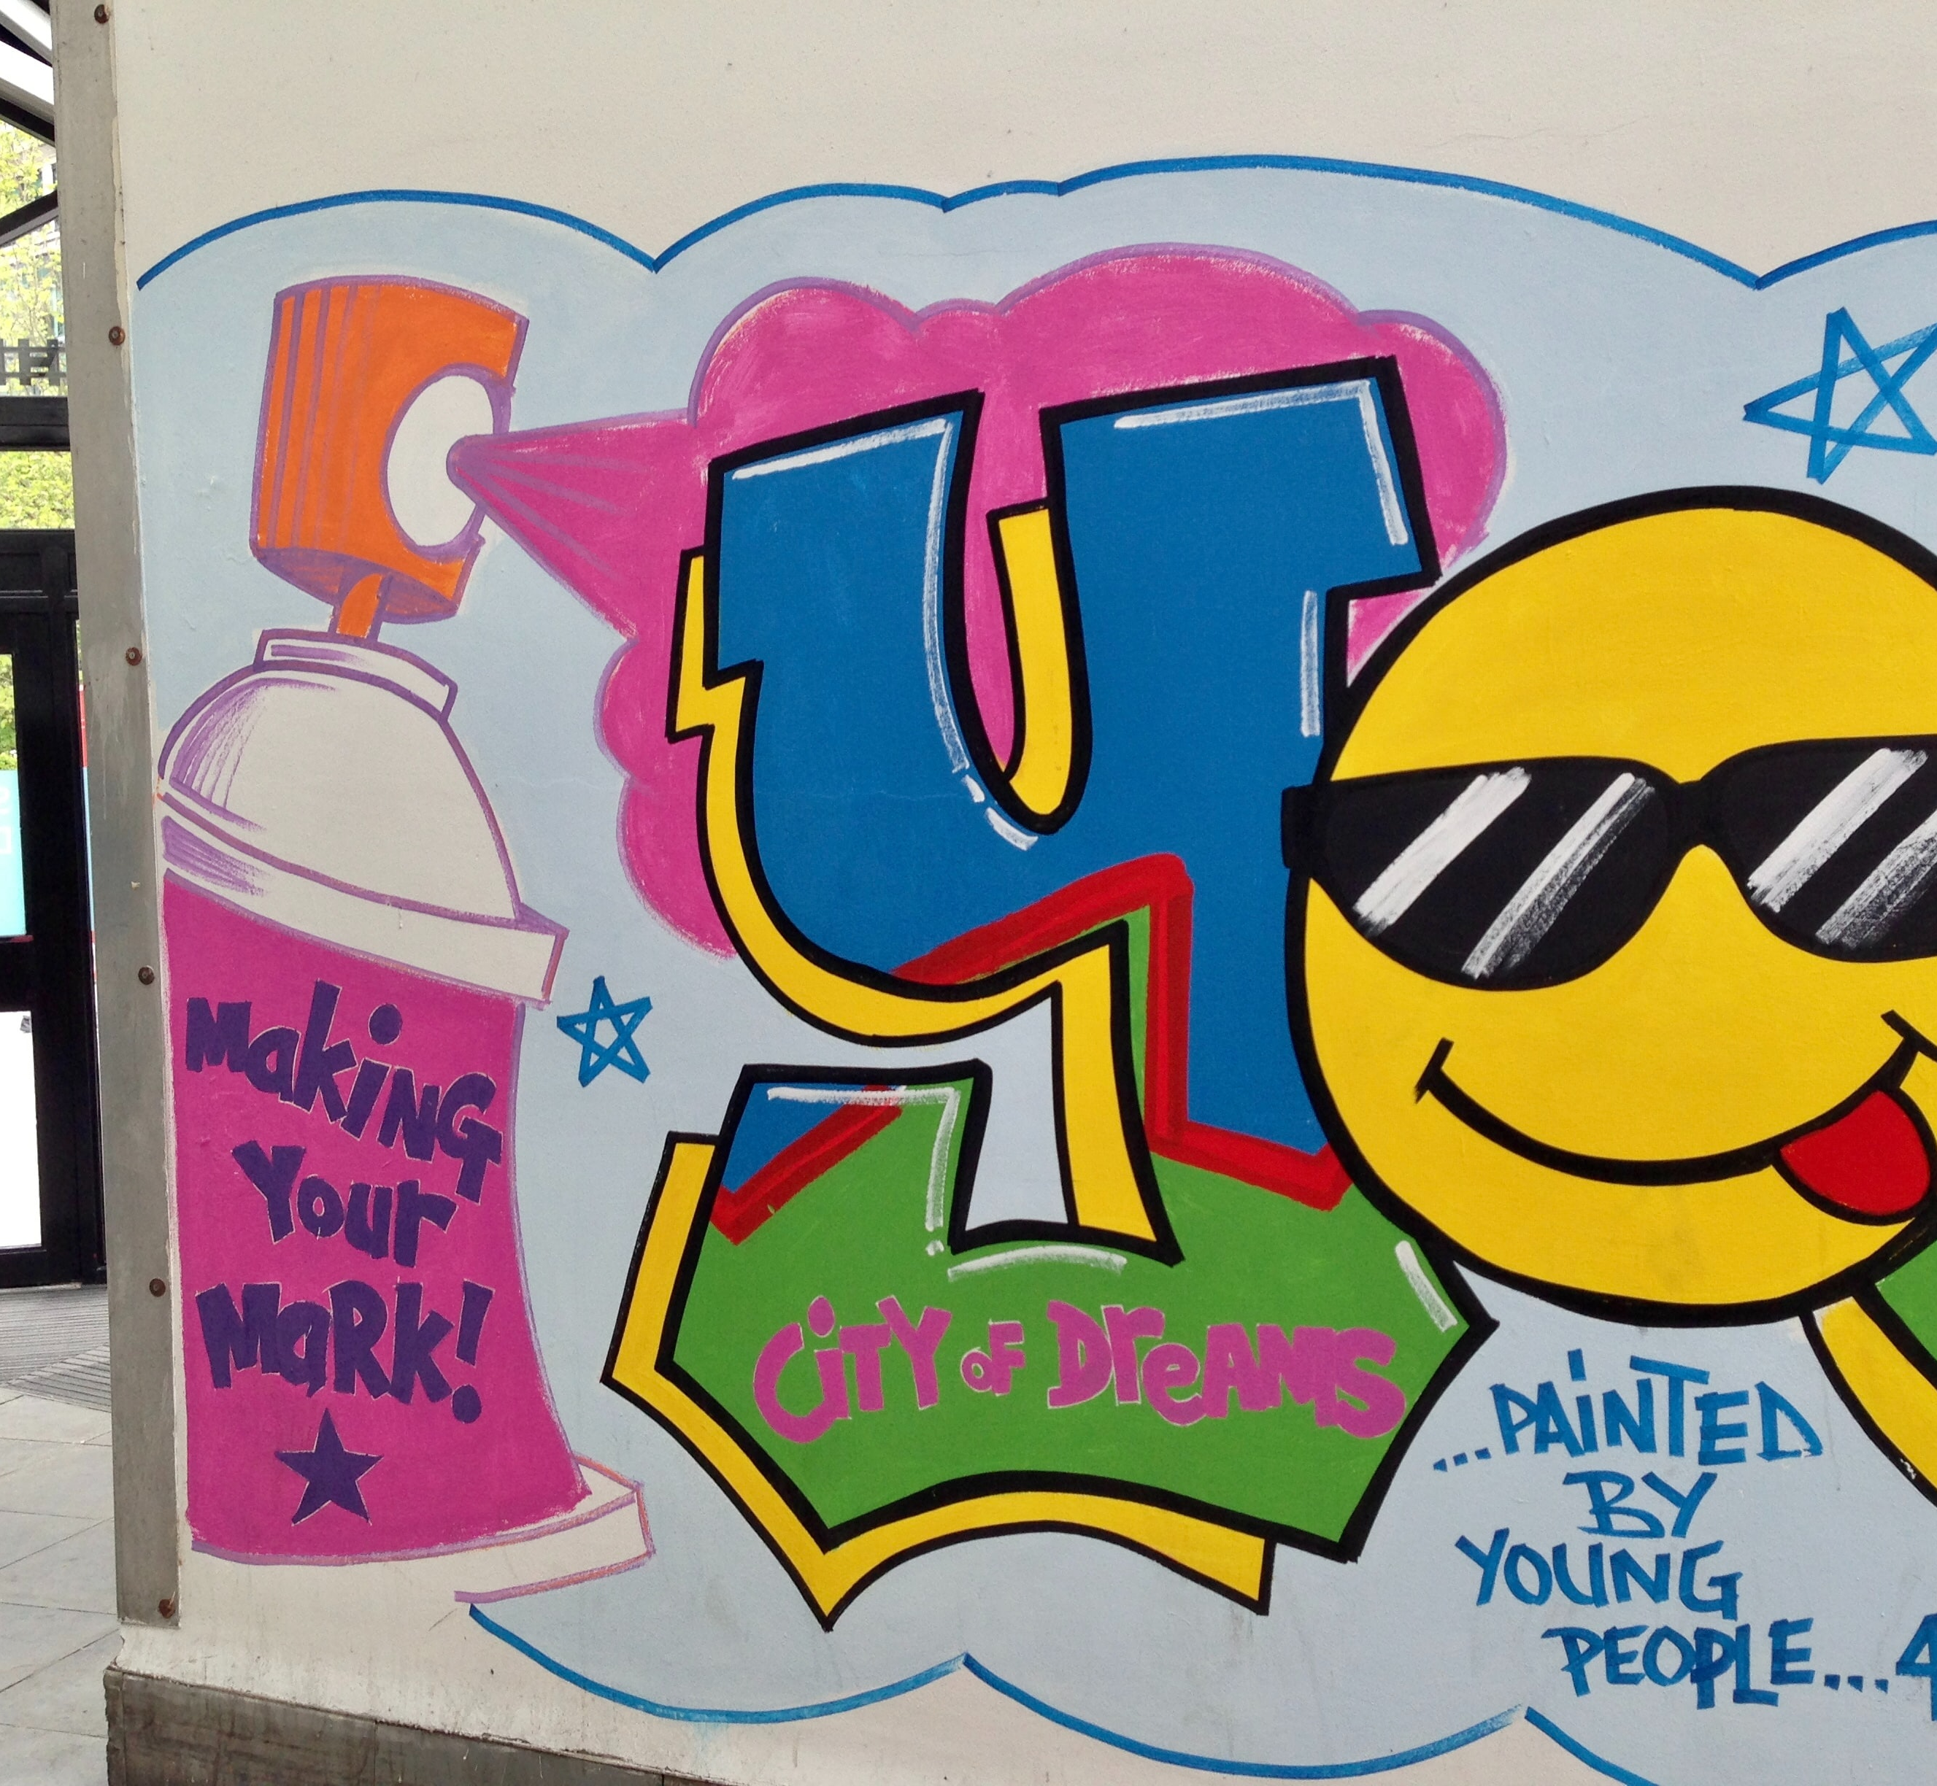

The Youth Engagement Network (YEN):
Innovating for Meaningful Youth Engagement Across Sexual & Reproductive Health Interventions
Azzia A. Roberts, MPH,CHES
YEN Learning & Engagement Specialist, ETR

Slide 2
Tier 2 Innovation and Impact Network
Funder: Office of Population Affairs
Grant Program: Teen Pregnancy Prevention Program (TPP)
Funding Goal: Thirteen grantees will establish, fund, coordinate, and support a multidisciplinary network of partners to develop and test innovative interventions in seven key priority areas and will disseminate those interventions that demonstrate effectiveness.
Project Period: July 2020 - July 2023

Slide 3
Environmental Scan
Goal:
To understand the overall context, current research, needs and resources related to youth engagement in sexual and reproductive health
Primary Questions
What is youth engagement?
What strategies and interventions exist?
What are the greatest needs and opportunities for innovation?
Methods
Review of peer reviewed and grey literature
Interviews with stakeholders

Slide 4
What are the greatest needs?
Sustainability of YE
Equitable access to technology
Connections to community and other youth
Explicit acknowledgment of racial and social justice
Affirming spaces
COVID-related challenges
Ensuring right adult facilitators
Strategies for engaging:
  LGBTQ youth, particularly queer youth of color and queer men of color
  Heterosexual, cisgender young men, particularly young Black men and young men of color
  Youth living in rural communities, particularly Latinx youth

Slide 5
Meaningful youth engagement
An inclusive, intentional, and mutually respectful partnership between youth and adults​
  Power is shared​
  Young people are valued​ and treated as experts
Young peoples’ ideas, perspectives, skills, and strengths are integrated into design, delivery, and evaluation
Young people contribute to changes that affect their lives, and their communities, countries, and world​
​Sharing of expertise is multi-directional and inter-generational.​

Slide 6

YEN Vision
We envision all young people have the ability and opportunity to be meaningfully and equitably engaged in the programs, policies, and systems that affect their lives and their communities.

Slide 7
YEN Goals
To strengthen meaningful and equitable engagement in sexual health programs, policies, and systems that affect young peoples' lives and their communities, especially among young people who experience systemic marginalization or discrimination.
To make a measurable impact on the youth engagement priority area, the YEN will:
Strengthen the number & coordination of partners committed to meaningfully engaging youth
Increase understanding of practices that meaningfully engage and give voice to youth in sexual health programs

Slide 8







YEN is guided by six core values
Youth at the Center
Health Equity
Involving young people who are directly impacted by programs and services.
Promoting youth’s agency and fair access to resources and opportunities.
Positive Sexuality
Curiosity, Innovation & Continuous Learning
An approach that honors pleasurable sexual relationships, trust, and communication.
Creative process that values curiosity, risk-taking, and new perspectives.
Trauma-Informed and Healing-Centered
Science
Using transdisciplinary and rigorous science to find the most effective youth engagement practices.
Conditions that promote safety, relationships, identity affirmation, hope, resilience and health.

Slide 9

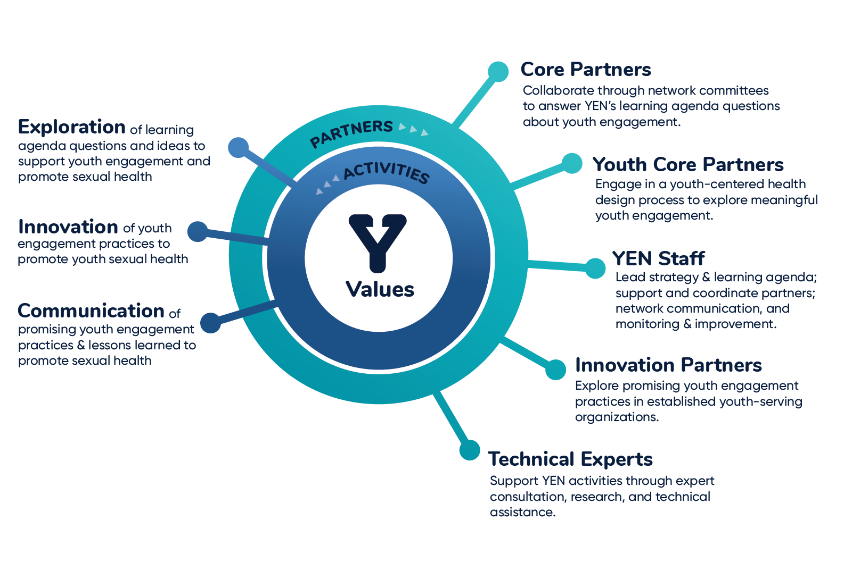
Youth Engagement Network (YEN)

Slide 10
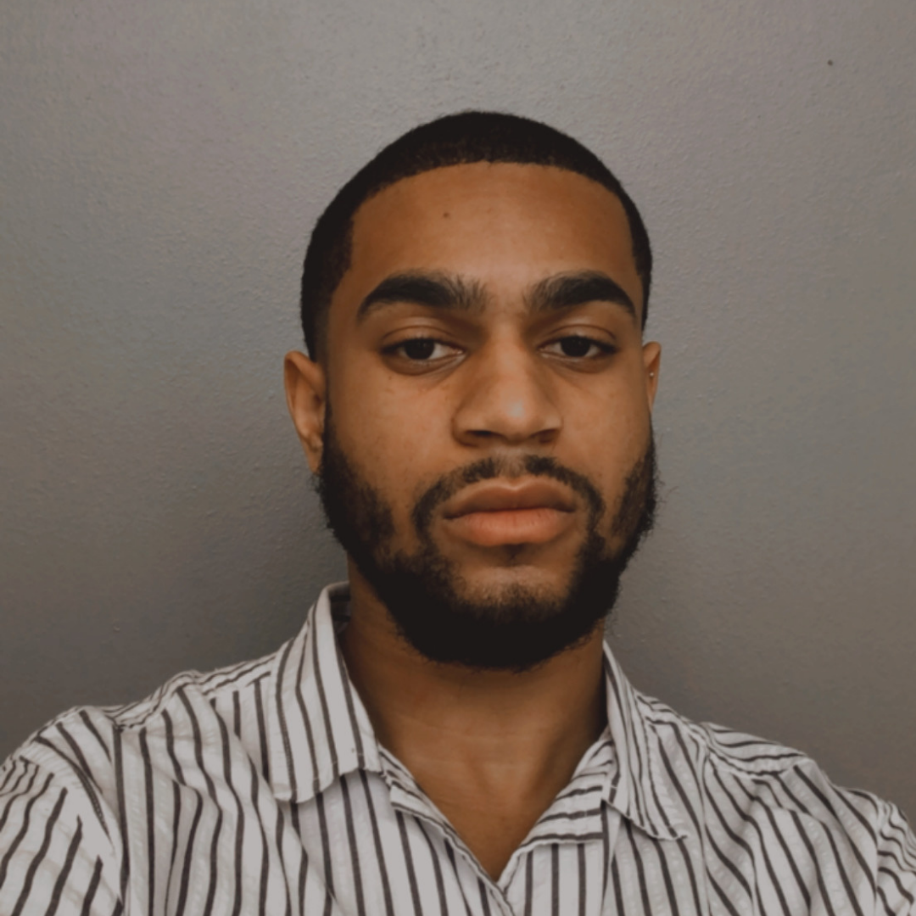





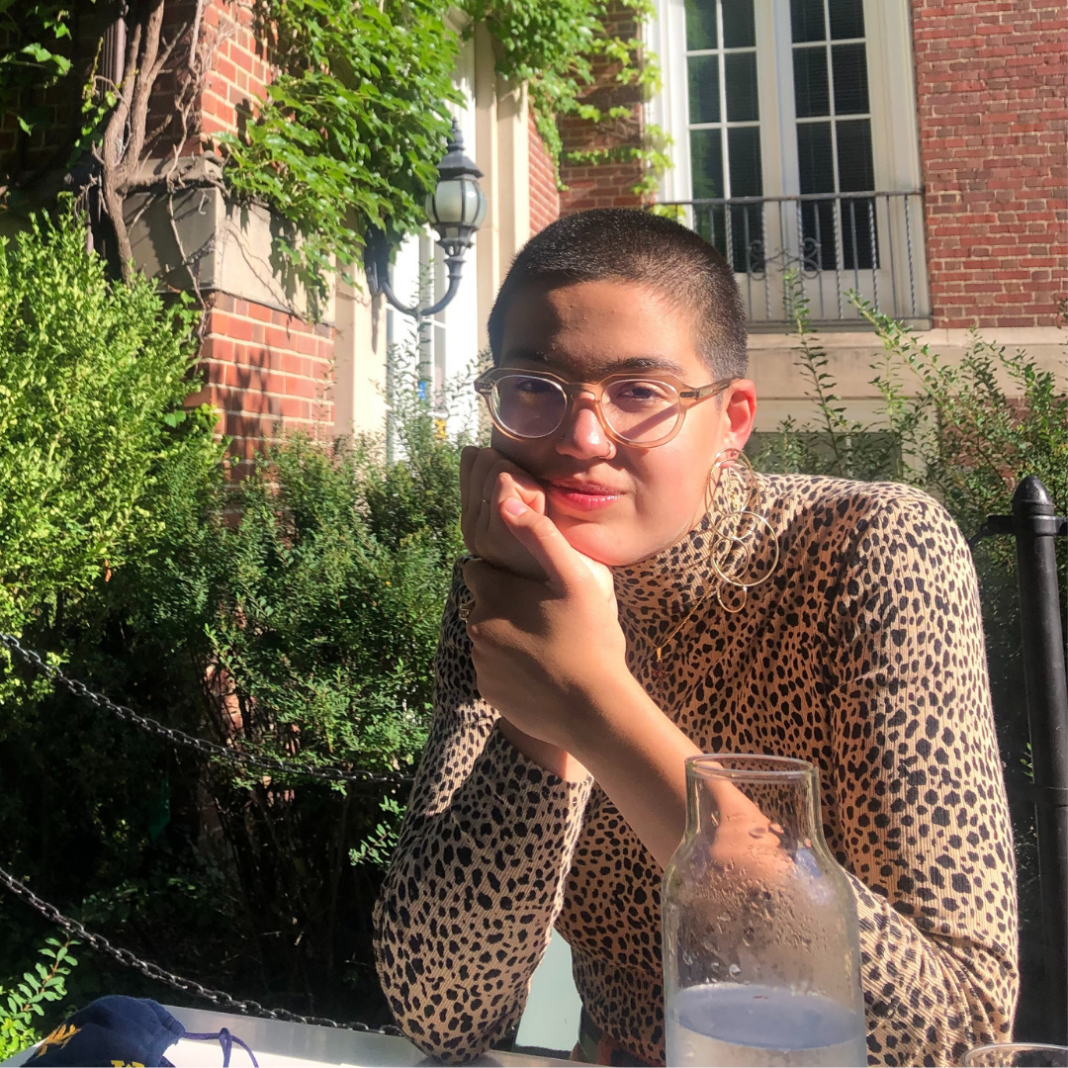
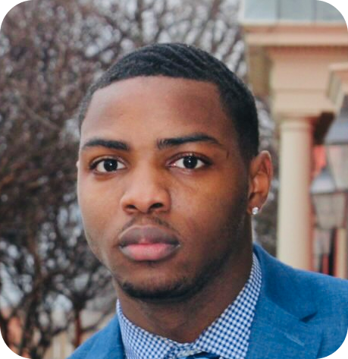



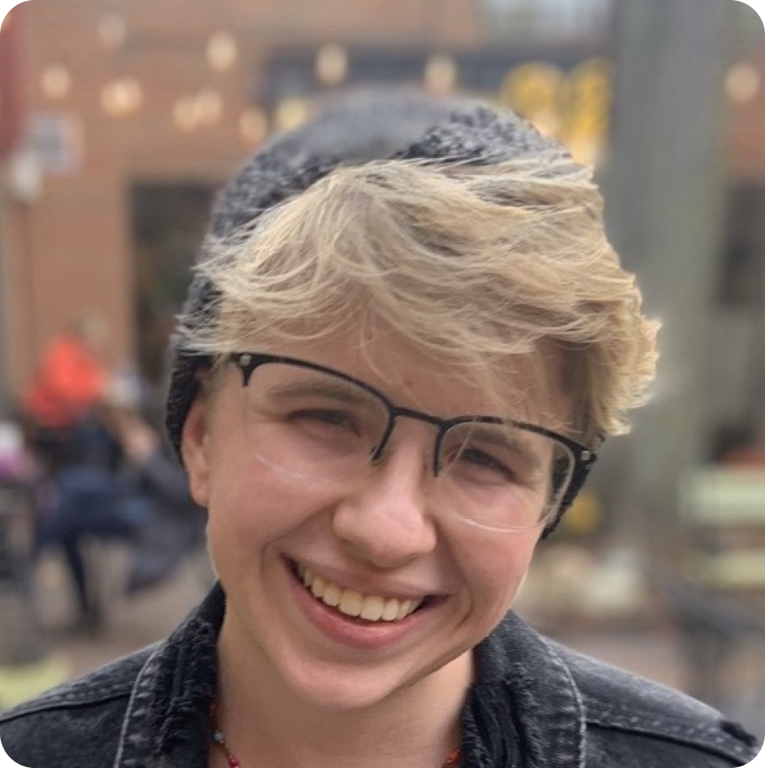


YEN Core Partners

Slide 11




Innovator Teams
Michigan Organization on Adolescent Sexual Health: The YAC Collective
Novelly: Speak! Leadership Academy
National Health Foundation: Be A STAR
Teen Health Mississippi: Mind Elevation (ME.) Project

Slide 12
Learning Agenda
Priority Youth
LGBT and queer BIPOC youth
Straight, cisgender BIPOC young men
Youth living in rural communities
For our priority youth:
What is the framework for meaningful youth engagement?
What are the barriers and facilitators to meaningfully engage youth?
What are the most promising practices to meaningfully engage youth?
What are best practices for adults and organizations to give voice to and share power with youth?
How do we measure meaningful youth engagement?

Slide 13





Azzia Roberts, MPH, CHES
YEN Learning & Engagement Specialist, ETR
Azzia.Roberts@etr.org
Connect with us!
ETR
ETR_Org
ETR
ETR.org/YEN

